Slide 1
BNFO 262 Module 4: Lecture 1 RNA-seq: Introduction
Rob Morey, PhD
remorey@health.ucsd.edu

Slide 2
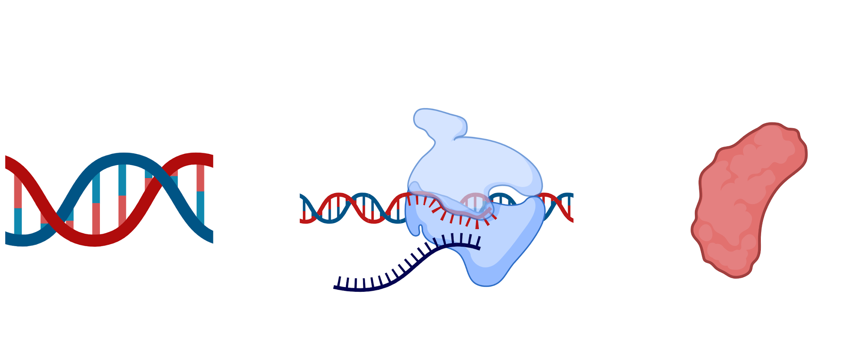
RNA-Seq: Studying Gene Expression
Transcription
Translation
DNA
mRNA
Protein
Cells/tissue → RNA sequencing → Study changes in gene expression
BNFO 262 Winter 2026​
Notes:
Figure: Biorender
Script:
-Central dogma of molecular biology is that DNA is transcribed into mRNA using RNA polymerases; RNA finds its way to a ribosome and is translated into proteins. Occurs In most biological cells with some exceptions such as retroviruses which convert RNA to DNA using reverse transcriptases.
-RNA Seq is a technique that uses next gen sequencing to analyze presence/quantity of RNA in cells/tissues- transcriptome
Information:
https://groups.inf.ed.ac.uk/bionlp/links/central-dogma.html
Exceptions such as retroviruses which use reverse transcriptases to convert RNA to DNA, and prions
The central dogma of molecular biology (sometimes Crick's central dogma after Francis Crick who coined the term and discovered some of the principles) states that the flow of genetic information is "DNA to RNA to protein". With a few notable exceptions, all biological cells conform to this rule.
The central dogma is not really a dogma in the traditional sense of the word, like all scientific theories it is modified as we learn more details of the processes.
The biggest revolution in the central dogma was the discovery of retroviruses, which transcribe RNA into DNA through the use of a special enzyme called reverse transcriptase has resulted in an exception to the central dogma; RNA → DNA → RNA → protein. Also, some virus species are so primitive that they use only RNA → proteins, having not developed DNA. With the discovery of prions, a new exception to the central dogma has been discovered, Protein → Protein.

Slide 3
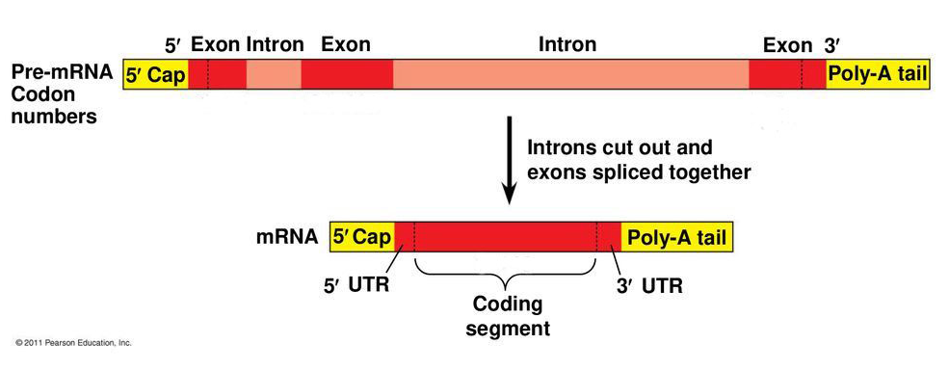

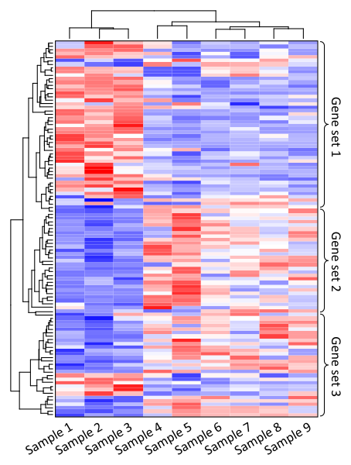

RNA-Seq: Sequencing the Transcriptome
Poly(A) tail
Poly(A) tail
Qualitative:
Expressed/novel transcripts (e.g. fusion genes in cancer)
Exon/intron boundaries
Quantitative:
Differences in transcript expression
Splice variants (e.g., tissue-specific isoforms)
BNFO 262 Winter 2026​
Notes:
Figures:
2011 Pearson Education - https://www.primatewatching.com/t-leucocephalus - https://commons.wikimedia.org
Script:
-Structure of mRNA: 5’ cap- stability, attachment point for ribosomes; 3’ polyA tail- prevents degradation. stability and so that mRNA can exit nucleus and find ribosome, splicing
-Qual- de novo transcriptomics- limestone langur
-Quant-DEG analysis
Information:
1-https://rnaseq.uoregon.edu/#exp-design
2-The reference genome and transcriptome of the limestone langur, Trachypithecus leucocephalus, reveal expansion of genes related to alkali tolerance
BMC Biol. 2021 Apr 8;19(1):67.
https://www.nature.com/scitable/definition/poly-a-tail-276/
The poly-A tail is a long chain of adenine nucleotides that is added to a messenger RNA (mRNA) molecule during RNA processing to increase the stability of the molecule. Immediately after a gene in a eukaryotic cell is transcribed, the new RNA molecule undergoes several modifications known as RNA processing. These modifications alter both ends of the primary RNA transcript to produce a mature mRNA molecule. The processing of the 3' end adds a poly-A tail to the RNA molecule. First, the 3' end of the transcript is cleaved to free a 3' hydroxyl. Then an enzyme called poly-A polymerase adds a chain of adenine nucleotides to the RNA. This process, called polyadenylation, adds a poly-A tail that is between 100 and 250 residues long. The poly-A tail makes the RNA molecule more stable and prevents its degradation. Additionally, the poly-A tail allows the mature messenger RNA molecule to be exported from the nucleus and translated into a protein by ribosomes in the cytoplasm.

Slide 4
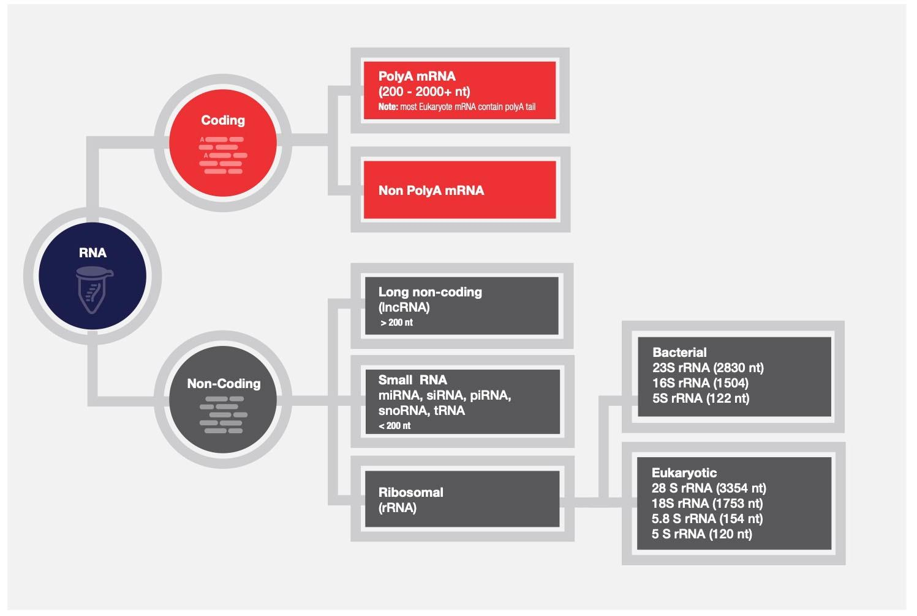
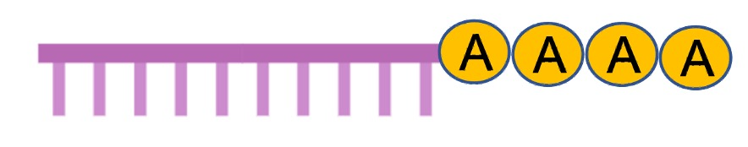
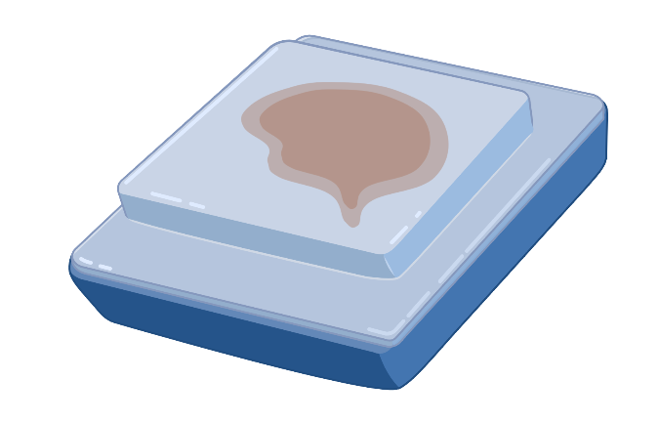

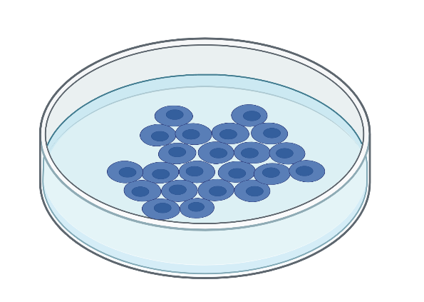

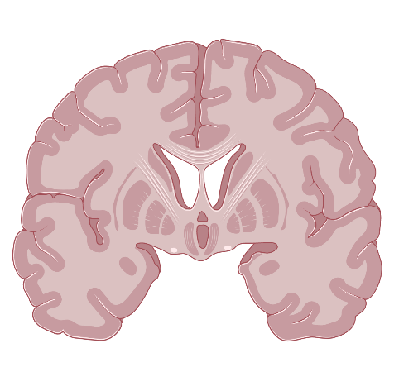
RNA-seq
Targeted RNA-Seq
DEG analysis
Small RNA-Seq
Whole transcriptome
BNFO 262 Winter 2026​
Notes:
Figure: Biorender
https://www.thermofisher.com/us/en/home/life-science/dna-rna-purification-analysis/rna-extraction/rna-applications/ribosomal-rna-depletion.html
Information: https://www.thermofisher.com/us/en/home/life-science/sequencing/sequencing-learning-center/next-generation-sequencing-information/ngs-basics/rna-sequencing-methods.html
Total RNA:
Whole transcriptome analysis
Coding and noncoding RNA
Potential inefficiencies and bias due to different sequencing lengths
Targeted RNA:
Sequencing specific transcripts of interest to analyze specific genes of interest
Degraded samples from FFPE
mRNA:
Poly(A) selection to sequence all messenger RNA for gene expression analysis
Identify novel and known content
Small RNA:
- Isolation of small RNA
miRNA, piRNA, tRNA etc.
Gene regulation

Slide 5
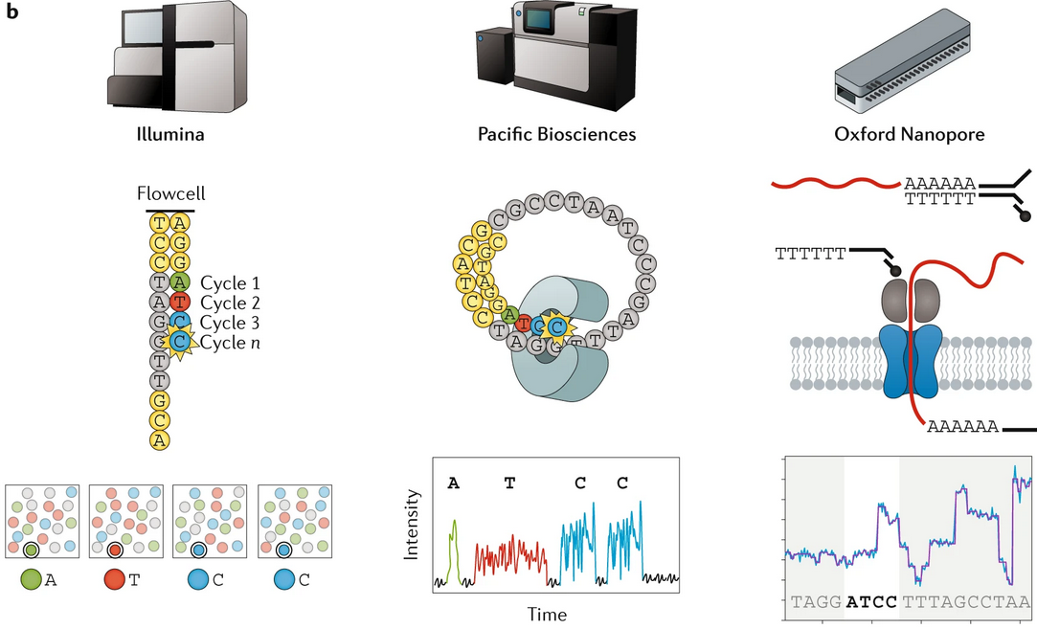
RNA-seq – the three main technologies
Short Read
Long Read
Direct
50bp - 300bp
> 10kb (Full transcript)
> 10kb (Full transcript)
BNFO 262 Winter 2026​
Notes:
Stark, R., Grzelak, M. & Hadfield, J. RNA sequencing: the teenage years. Nat Rev Genet 20, 631–656 (2019). https://doi.org/10.1038/s41576-019-0150-2
The three main sequencing technologies for RNA-seq. The Illumina workflow (left panel): after library preparation, individual cDNA molecules are clustered on a flowcell for sequencing by synthesis using 3΄ blocked fluorescently labelled nucleotides. In each round of sequencing, the growing DNA strand is imaged to detect which of the four fluorophores has been incorporated, and reads of 50–500 bp can be generated. The Pacific Biosciences workflow (middle panel): after library preparation, individual molecules are loaded into a sequencing chip, where they bind to a polymerase immobilized at the bottom of a nanowell. As each of the fluorescently labelled nucleotides is incorporated into the growing strand, they fluoresce and are detected, and reads of up to 50 kb can be generated. The Oxford Nanopore workflow (right panel): after library preparation, individual molecules are loaded into a flowcell, where motor proteins, which are attached during adaptor ligation, dock with nanopores. The motor protein controls the translocation of the RNA strand through the nanopore, causing a change in current that is processed to generate sequencing reads of 1–10 kb.

Slide 6
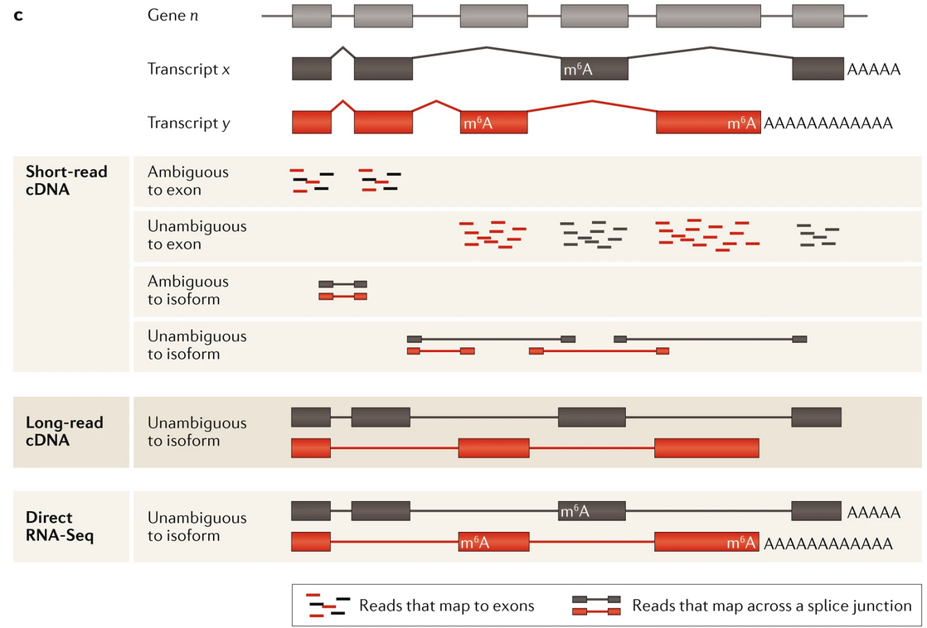
RNA-seq – the three main technologies
BNFO 262 Winter 2026​
Notes:
Stark, R., Grzelak, M. & Hadfield, J. RNA sequencing: the teenage years. Nat Rev Genet 20, 631–656 (2019). https://doi.org/10.1038/s41576-019-0150-2
Comparison of short-read, long-read and direct RNA-seq analysis. Over 90% of human genes (gene n) are alternatively spliced to form two or more distinct and expressed isoforms (transcripts x and y). The complexity of information captured increases from short-read cDNA sequencing, where isoform detection can be compromised by reads that cannot be mapped unambiguously, to long-read methods that directly sequence isoforms. In short-read cDNA sequencing, a significant proportion of reads map ambiguously when an exon is shared between isoforms; reads that span exon–exon junctions can be used to improve the isoform analysis but can also be mapped ambiguously when a junction is shared between isoforms. These issues complicate analysis and the interpretation of results.
Long-read cDNA methods can generate full-length isoform reads that remove, or substantially reduce, these artefacts and improve differential isoform expression analysis. However, these methods rely on cDNA conversion, which removes information about RNA base modifications and can only make crude estimates of polyadenylation (poly(A)) tail length.
Direct RNA-seq enables full-length isoform analysis, base modification detection (such as N6-methyladenosine (m6A)) and poly(A) tail length estimation.

Slide 7
RNA-Seq: Workflow Overview Part 1
1. Data generation
Illumina short reads workflow
Experimental design
RNA extraction/enrichment
Library preparation
QC
Sequencing
BNFO 262 Winter 2026​
Notes:
https://wiki.illinois.edu/wiki/display/HPCBio/Fall+RNA-Seq+Workshop
https://rnaseq.uoregon.edu/#exp-design

Slide 8
RNA-Seq: Workflow Overview Part 2
2. Data analysis
Filtering
Normalization
Statistical Analysis
Data Mining
Trimming
Alignment
Biological interpretation
Read counts
QC
Trimmomatic
cutAdapt
STAR
Salmon/Kallisto (alignment-free)
featureCounts (subread)
RSEM
HTSeq
FastQC, MultiQC
Samtools
BNFO 262 Winter 2026​
Notes:
https://wiki.illinois.edu/wiki/display/HPCBio/Fall+RNA-Seq+Workshop
https://rnaseq.uoregon.edu/#exp-design

Slide 9
Part 1: Data Generation
BNFO 262 Winter 2026​

Slide 10
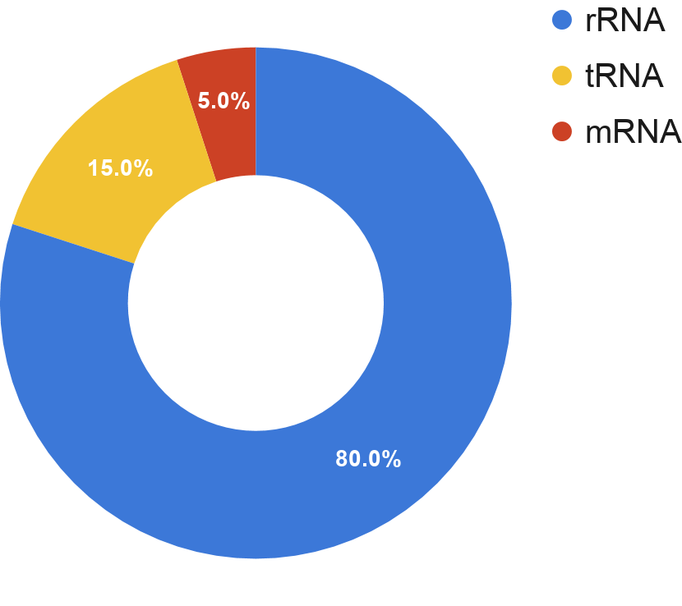
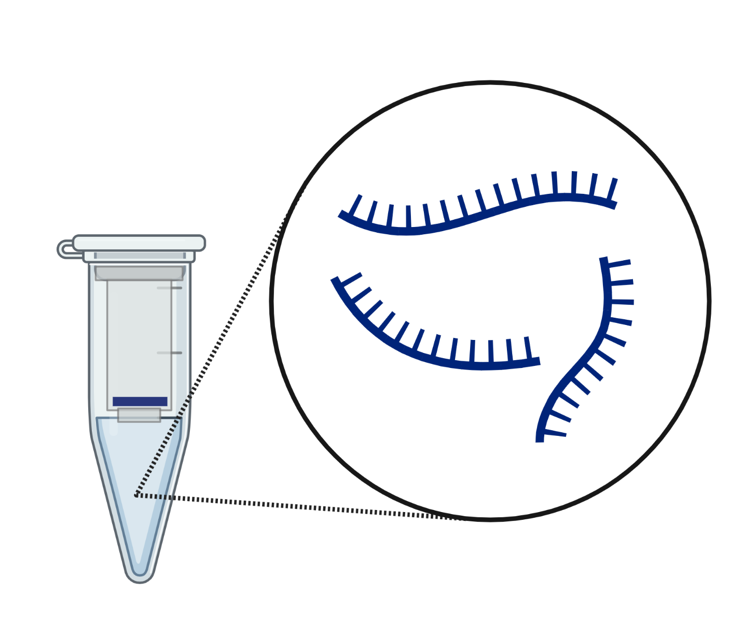
RNA Extraction/Enrichment
RNA extraction
Common methods:
Silica gel-based membranes
Phenol-chloroform
Replicates: biological/technical
RNA enrichment:
Ribosomal RNA (rRNA) depletion
Poly(A) selection
BNFO 262 Winter 2026​
Notes:
Figure by BioRender
Script:
-RNA extraction – binding of RNA to silica gel based membranes - negative charge of the nucleic acid backbone interacting with positively charged sites on the silica surface
-Phenol/chloroform extraction with separation into aqueous phase with RNA, organic phase, interphase - the nucleic acid is more soluble in the aqueous phase of the extraction, while the proteins and lipids are more soluble in the organic phase
-RNA enrichment can happen in the library prep stage as explained in next few slides
-rRNA is non-coding RNA which is a primary component of ribosomes, makes up 80% of cellular RNA
-tRNA is an adaptor molecule that serves as physical link between mRNA and amino acid sequence of protein, necessary for translation
-mRNA protein coding
Information:
https://www.nature.com/articles/s41598-018-23226-4
Standard approaches include selection of polyadenylated RNA (polyA) transcripts using oligo (dT) primers, and depletion of highly abundant rRNAs through hybridization capture followed by magnetic bead separation. However, the polyA+ selection and rRNA depletion methods each have unique advantages and limitations. polyA+ selection is used for most transcriptome studies because the sequencing depth required is relatively low when the focus is mainly on the protein-coding fraction of a transcriptome⁸. Several recent studies have noted that although rRNA-depleted RNA libraries cost more than polyA+ selection libraries to achieve comparable coverage of protein-coding reads in a transcriptome, it provides more information on polyA- transcripts. Another technical advantage that favours RNA-seq of rRNA-depleted libraries compared with polyA-selected libraries is that its performance is better for degraded RNAs
https://www.thermofisher.com/us/en/home/life-science/dna-rna-purification-analysis/rna-extraction/rna-applications/ribosomal-rna-depletion.html
Ribosomal RNA is a type of non-coding RNA which is the primary component of ribosomes, essential to all cells. Ribosomal RNA is transcribed from ribosomal DNA (rDNA) and then bound to ribosomal proteins to form small and large ribosome subunits. rRNA is the physical and mechanical actor of the ribosome that forces transfer RNA (tRNA) and messenger RNA (mRNA) to process and translate the latter into proteins.^{[1]} Ribosomal RNA is the predominant form of RNA found in most cells; it makes up >80% of cellular RNA despite never being translated into proteins itself.
https://chagall.med.cornell.edu/RNASEQcourse/Intro2RNAseq.pdf

Slide 11

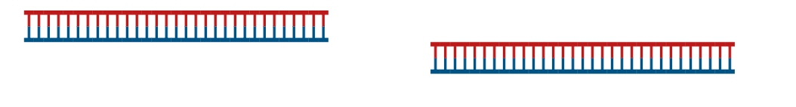


Library Preparation – preparing the RNA
RNA extraction
Total RNA
Library preparation
Removal of contaminant DNA
rRNA depletion (-) or
Poly(A) selection (+)
RNA fragmentation
When do you choose rRNA depletion and when do you choose polyA selection? Why do we fragment the RNA?
BNFO 262 Winter 2026​
Notes:
Figures: Biorender
Script:
Lib prep broadly consist of these steps
Total RNA including mRNA
Removal of genomic DNA
Either rRNA depletion (hybridization to complementary biotinylated oligo probes) or Poly A selection (oligo dT primers) but you lose non-polyA transcripts etc
RNA fragmentation- enzymatic/heat/sonication
Information:
https://rnaseq.uoregon.edu/#library-prep
https://www.labome.com/method/RNA-seq.html
Library preparation
Library preparation can be accomplished through commercial kits such as the NEXTflex kit from Bioo Scientific) [13], SMARTer Stranded RNA-Seq Kits from Takara (634837) [16] or SMART-Seq® v4 Ultra® Low Input RNA Kit from Takara (634890) with Nextera XT DNA Library Prep Kit from Illumina (FC-131-1096) [17], TruSeq from Illumina [18, 19], Ovation SoLo kit from NuGEN (0501-32) [20], or their variants [14, 21]. Library preparation consists of:
RNA fragmentation
Unlike short RNAs, mRNAs are typically fragmented to smaller pieces of RNA to enable sequencing.
https://rnaseq.uoregon.edu/#library-prep
Most current sequencing platforms are capable of providing only relatively short sequence reads (~40-400bp depending upon the platform). Therefore, most protocols incorporate a fragmentation step to improve sequence coverage over the transcriptome. However, protocols differ as to when the fragmentation is performed. Most of the original protocols fragmented cDNA; however, fragmentation of the RNA (before converting it to cDNA) is becoming more popular. Four different methods are commonly used to fragment RNA: enzymatic, metal ion, heat, and sonication. Although all of these methods are commonly used to fragment RNA, little information has been published comparing their relative performance. The goal is to produce a population of RNA fragments that are on average about 200 bp. The effectiveness of the fragmentation reaction should be assessed by evaluating the RNA on a gel or by using an Agilent Bioanalyzer

Slide 12
Library Preparation – Reverse transcribing RNA to cDNA
RNA extraction
5’
3’
First strand synthesis
Second strand synthesis
5’
3’
Library preparation
P
3’ ends adenylated
5’ ends repaired
P
5’
3’
Sequencing adapters ligated
3’
5’
BNFO 262 Winter 2026​
Notes:
Figure: Biorender
Script:
Reverse transcriptase is used to synthesize a DNA strand using RNA as a template (oligo-dT/random priming)
Second cDNA strand synthesized from first strand using DNA polymerase
Adapters ligated to each end
Information:
https://rnaseq.uoregon.edu/#library-prep
https://www.labome.com/method/RNA-seq.html
Library preparation
Reverse transcription
First and second strand cDNA is reverse transcribed from fragmented RNA using random hexamers or oligo(dT) primers.
Oligo dT- 3’ bias, non polyA mRNAs lost
Random priming- ncRNAs, no 3’ bias. Priming hotspots observed
Adapter ligation
The 5’ and/or 3’ ends of cDNA are repaired, and adapters (containing sequences to allow hybridization to a flow cell) are ligated.
Most of the current sequencing platforms use clonal amplification to create clusters of identical molecules that are tethered next to each other on a solid support. For the Illumina platform the clusters are attached to the surface of a flow-cell, while for the 454, IonTorrent, and SOLiD platforms the clusters are generated on beads using emulsion PCR. Regardless of the platform, two types of sequence elements are required: (1) Terminal platform-dependent sequences that are required for clonal amplification and attachment to the sequencing support. (2) Sequences for priming the sequencing reaction. In addition several optional elements may be present. These include sequence tags to allow for multiplexing (known as barcodes or indices), and a second sequence-priming site to allow for sequencing of the insert from the other side (known as paired-end sequencing).

Slide 13
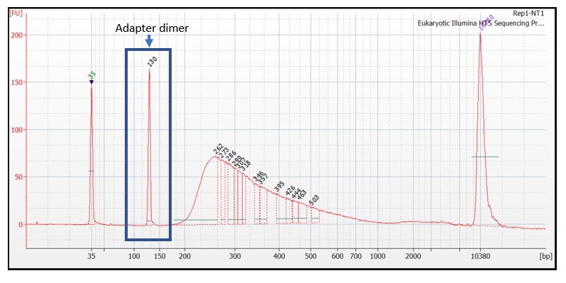
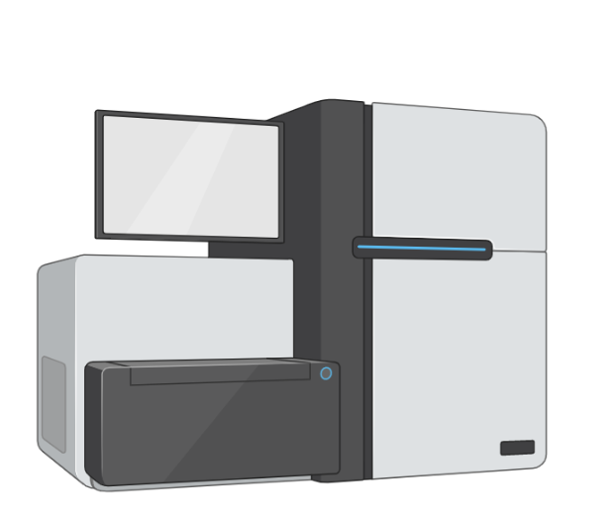
Library Preparation – Amplifying and sequencing
RNA extraction
PCR amplification
Size selection
Index 2
Insert
Index 1
5’
3’
5’
3’
P5
Rd 1 SP
Rd2 SP
P7
Library preparation
Quality control
Bioanalyzer trace
Sequencing
Reads
Sequencing
BNFO 262 Winter 2026​
https://www.illumina.com/library-prep-array-kit-selector.html
Notes:
Figure: Biorender
BioA: https://support.illumina.com/bulletins/2020/12/how-short-inserts-affect-sequencing-performance.html
https://support.illumina.com/bulletins/2019/10/what-are-adapter-dimers-.html
https://rnaseq.uoregon.edu/#library-prep
https://support.illumina.com/bulletins/2020/06/illumina-adapter-portfolio.html
Script:
-Adapters contain:
Sequences that allow the library to bind and generate clusters on the flow cell (p5 and p7 sequences)
Sequencing primer binding sites to initiate sequencing (Rd1 SP and Rd2 SP)
Index sequences (Index 1 and, where applicable, Index 2), which are sample identifiers that allow multiplexing/pooling of multiple samples in a single sequencing run or flow cell lane.
-QC is conducted, bioA to check library size. BioA measures size in terms of fluorescence units. Adapter dimer is a distinct peak to look for, and is the reason size selection is done.
-Sequencing is conducted. Several different types of Illumina Sequencers
-Adapter dimers contain full-length adapter sequences that are able to bind and cluster on the flow cell and generate sequencing data. In contrast, primer dimers do not contain complete adapter sequences, and are not able to bind or cluster on the flow cell, so are not sequenced.
-Show library prep kit and array selector for Illumina
https://www.labome.com/method/RNA-seq.html
Library cleanup and amplification
Libraries are enriched for correctly ligated cDNA fragments and amplified by PCR to add any remaining sequencing primer sequences.
Library quantification, quality control and sequencing
Library concentration is assessed using qRT-PCR and/or Bioanalyzer, for example, Agilent Bioanalyzer 2100 [22], and is ready for sequencing.

Slide 14
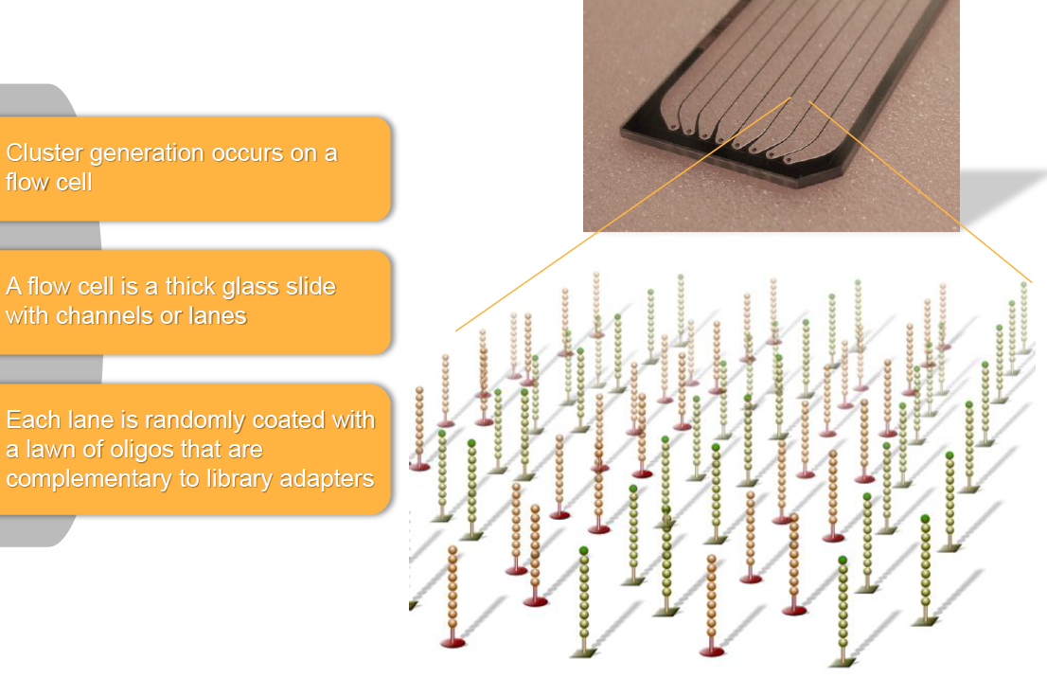
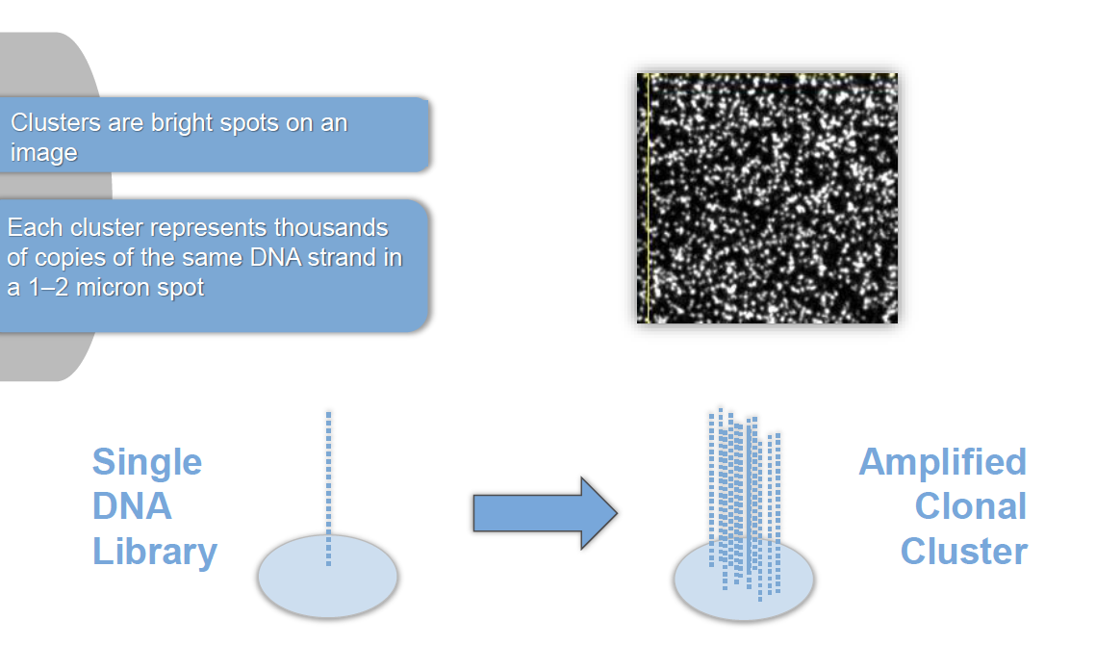
Sequencing on Illumina Flow Cell
BNFO 262 Winter 2026​
Notes:
Information and figures:
https://www.well.ox.ac.uk/ogc/wp-content/uploads/2017/09/Illumina_Sequencing_Overview_15045845_D.pdf
Script:
Cluster generation occurs on an Illumina Flow cell
Flow cell is a glass slide with channels or lanes
There are coated with oligos that are complementary to lib adapters
Each “cluster” is a bright spot on the image
Each single DNA strand is amplified to thousands of copies in an amplified clonal cluster

Slide 15
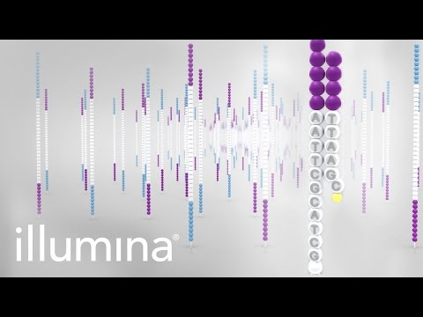
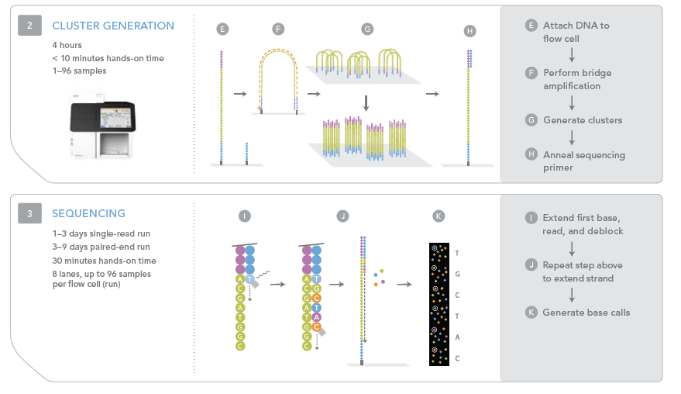
Illumina SBS: Sequencing by Synthesis
https://www.youtube.com/watch?v=fCd6B5HRaZ8 : 5 min summary
https://www.youtube.com/watch?v=oIJaA6h2bFM : 40 min, more detailed
BNFO 262 Winter 2026​
Notes:
Figures: Illumina
Script: Watch 5 min video
-As mentioned in the video, cluster generation occurs by bridge amplification.
-In a process called sequencing by synthesis (SBS), chemically modified nucleotides bind to the DNA template strand through natural complementarity
-The nucleotide order of each fragment is revealed through PCR with fluorophore-labelled nucleotides
-Images are taken after each round of nucleotide incorporation and bases are identified based on the recorded excitation spectra.
-Each nucleotide contains a fluorescent tag and a reversible terminator that blocks incorporation of the next base
-The fluorescent signal indicates which nucleotide has been added, and the terminator is cleaved so the next base can bind.
-After reading the forward DNA strand, the reads are washed away, and the process repeats for the reverse strand. This method is called paired-end sequencing.
-DNA polymerase- adds NT to DNA strand. RNA polymerase- copies DNA into an RNA sequence (transcription)
Information: https://chagall.med.cornell.edu/RNASEQcourse/Intro2RNAseq.pdf
The different steps of sequencing with Illumina’s sequencing by synthesis method. Library preparation: Adapters are ligated to each cDNA fragment to eventually attach them to the flowcell on which they are going to be sequenced. To increase the signal of the sequencing step, every fragment is first clonally amplified after the hybridization onto the flowcell (cluster generation). Finally, the nucleotide order of each fragment is revealed through PCR with fluorophore-labelled nucleotides: Images are taken after each round of nucleotide incorporation and bases are identified based on the recorded excitation spectra. Figure from Illumina.
During the sequencing step of the NGS workflow, libraries are loaded onto a flow cell and placed on the sequencer. The clusters of DNA fragments are amplified in a process called cluster generation, resulting in millions of copies of single-stranded DNA. On most Illumina sequencing instruments, clustering occurs automatically.
In a process called sequencing by synthesis (SBS), chemically modified nucleotides bind to the DNA template strand through natural complementarity. Each nucleotide contains a fluorescent tag and a reversible terminator that blocks incorporation of the next base. The fluorescent signal indicates which nucleotide has been added, and the terminator is cleaved so the next base can bind.
After reading the forward DNA strand, the reads are washed away, and the process repeats for the reverse strand. This method is called paired-end sequencing.
https://www.aatbio.com/resources/faq-frequently-asked-questions/How-does-bridge-amplification-work-in-next-generation-sequencing-NGS
Bridge amplification takes place in a flow cell, aiming to generating clusters of DNA strands for further sequencing and analysis. The flow cell is coated with two types of oligos, complementary to the two adapters on the fragment strand, respectively. Once the fragment strand is added to the flow cell, it hybridizes to one of the oligos on the cell surface. A polymerase then moves along the strand, creating its complementary DNA strand, i.e. the reverse strand. The double-stranded DNA is denatured and the original strand (forward strand) is washed away. The remaining reverse strand then folds over and its adapter region hybridizes to the second type of oligo on the flow cell. Polymerase attaches to the reverse strand and generates the complementary strand that is identical to the forward strand, forming a double-stranded bridge. This bridge is then denatured, resulting in two single-stranded copies of the DNA, forward and reverse strand, anchored to the flow cell. By repeating this denaturation and extension process, millions of fragments are amplified, forming localized clusters on the flow cell.

Slide 16
Common Terminology: Read Length
Sequencing read
5’
3’
Read length
100 bp
Reference
Single-end sequencing
Paired-end sequencing
Application | Read length
Transcriptome analysis | 2 x 75 bp
Gene expression profiling | 1 x 50 bp
Small RNA-Seq | 1 x 50 bp
BNFO 262 Winter 2026​
Notes:
Script:
Read length refers to the number of base pairs (bp) sequenced from a DNA fragment
After sequencing, the regions of overlap between reads are used to assemble and align the reads to a reference genome, reconstructing the full DNA sequence
Single-read sequencing involves sequencing DNA fragments from one end to the other. It is useful for some applications, such as small RNA sequencing, and can be a fast and economical option.
With paired-end sequencing, after a DNA fragment is read from one end, the process starts again in the other direction. In addition to producing twice the number of sequencing reads, this method enables more accurate read alignment and detection of structural rearrangements
Information:
https://www.illumina.com/science/technology/next-generation-sequencing/plan-experiments/read-length.html
Next-generation sequencing (NGS) read length refers to the number of base pairs (bp) sequenced from a DNA fragment. After sequencing, the regions of overlap between reads are used to assemble and align the reads to a reference genome, reconstructing the full DNA sequence. Sequencing read lengths correspond directly to the sequencing reagents used on an NGS instrument—more chemistry cycles generate longer reads.
There are two sequencing read types: single-read and paired-end sequencing. Single-read sequencing involves sequencing DNA fragments from one end to the other. It is useful for some applications, such as small RNA sequencing, and can be a fast and economical option.
With paired-end sequencing, after a DNA fragment is read from one end, the process starts again in the other direction. In addition to producing twice the number of sequencing reads, this method enables more accurate read alignment and detection of structural rearrangements. Today, most researchers use the paired-end approach.

Slide 17
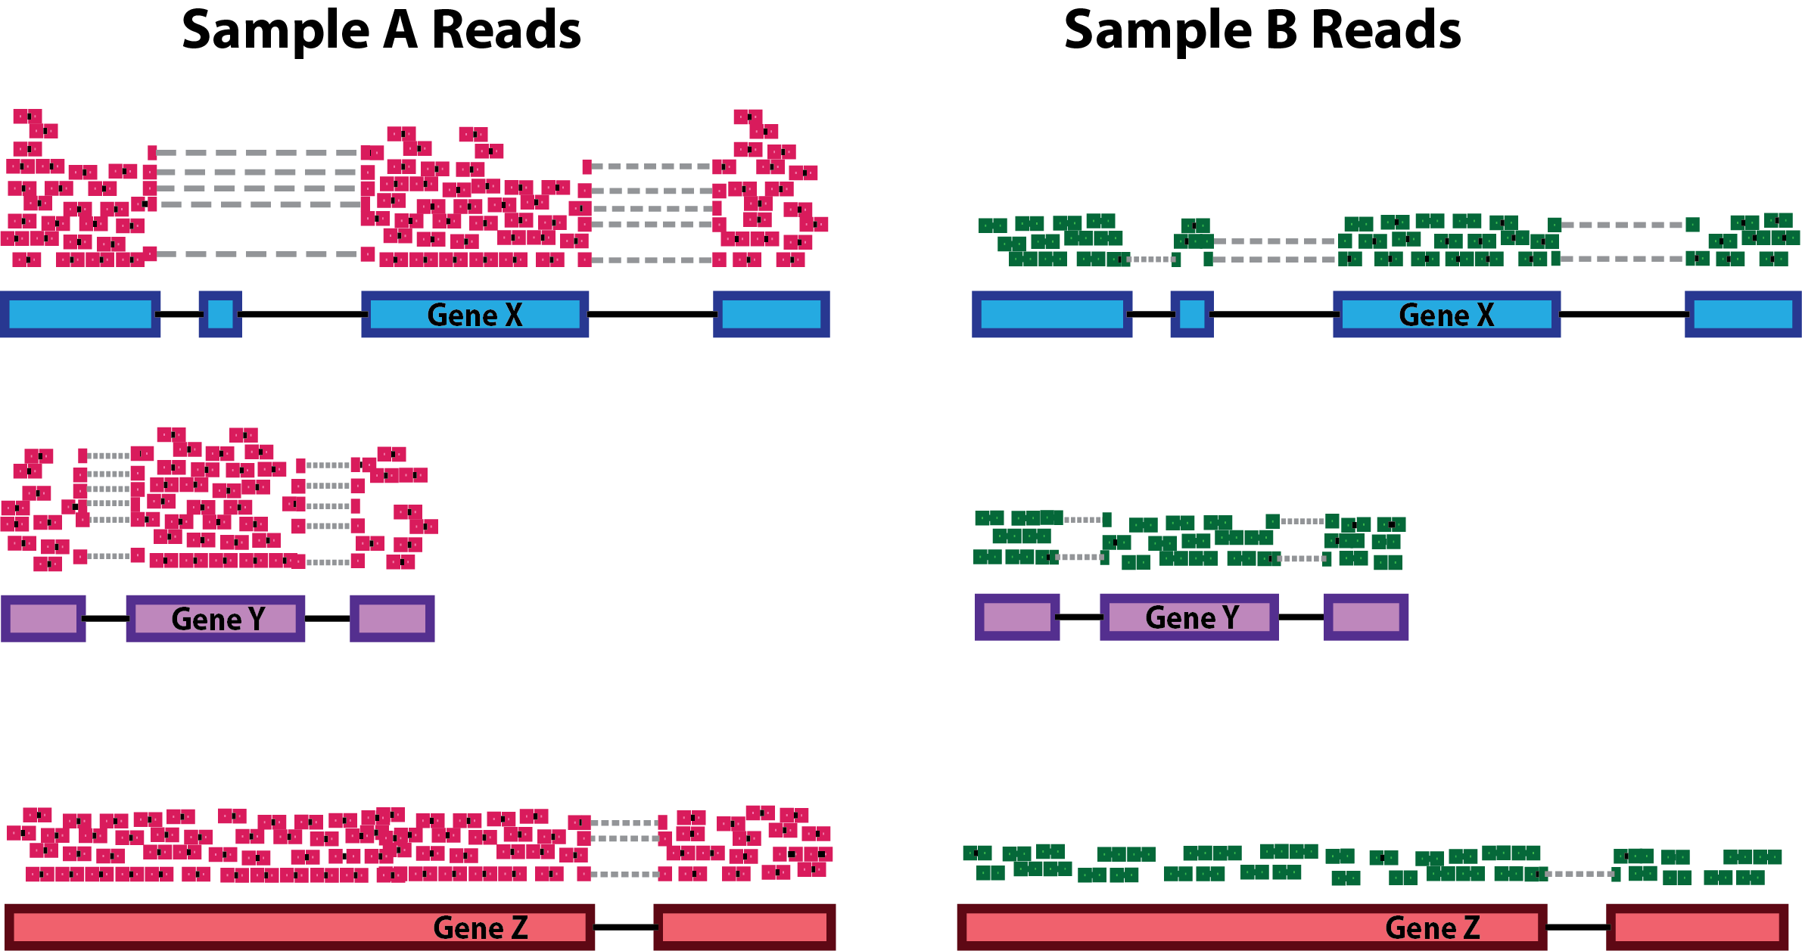
Sequencing Depth
Application | Reads/sample
Transcriptome analysis | 30-60 x 10⁶
Gene expression profiling | 5-25 x 10⁶
De novo transcriptomic profiling | 100-200 x 10⁶
Small RNA-Seq | 1-5 x 10⁶
Sequencing depth: Number of reads per sample
Number of reads per flow cell / number of reads per sample=Number of samples per flow cell
https://support.illumina.com/downloads/sequencing_coverage_calculator.html
Note: 10-30M reads for human differential expression analysis, 50-100M for novel transcript discovery
BNFO 262 Winter 2026​
Notes:
Figure: https://hbctraining.github.io/DGE_workshop/lessons/02_DGE_count_normalization.html
Script:
Number of reads in a sample
Explain example
Recommended no. of reads
Information:
https://hbctraining.github.io/DGE_workshop/lessons/02_DGE_count_normalization.html
Sequencing depth: Accounting for sequencing depth is necessary for comparison of gene expression between samples. In the example below, each gene appears to have doubled in expression in Sample A relative to Sample B, however this is a consequence of Sample A having double the sequencing depth.
https://support.illumina.com/bulletins/2017/04/considerations-for-rna-seq-read-length-and-coverage-.html
Gene expression profiling experiments that are looking for a quick snapshot of highly expressed genes may only need 5–25 million reads per sample. In these cases, researchers can pool multiple RNA-Seq samples into one lane of a sequencing run, which allows for high multiplexing of samples.
Experiments looking for a more global view of gene expression, and some information on alternative splicing, typically require 30–60 million reads per sample. This range encompasses most published RNA-Seq experiments for mRNA/whole transcriptome sequencing.
https://www.illumina.com/content/dam/illumina-marketing/documents/products/technotes/technote_coverage_calculation.pdf

Slide 18

Break: 5 min
BNFO 262 Winter 2026​

Slide 19
Part 2: Data Analysis
BNFO 262 Winter 2026​

Slide 20
RNA-Seq: Workflow Overview Part 2
2. Data analysis
Filtering
Normalization
Statistical Analysis
Data Mining
Trimming
Alignment
Biological interpretation
Read counts
QC
Trimmomatic
cutAdapt
STAR
Salmon/Kallisto (alignment-free)
featureCounts (subread)
RSEM
HTSeq
FastQC, MultiQC
Samtools
BNFO 262 Winter 2026​
Notes:
https://wiki.illinois.edu/wiki/display/HPCBio/Fall+RNA-Seq+Workshop
https://rnaseq.uoregon.edu/#exp-design

Slide 21
File types
FASTQ
SAM/BAM
Counts Matrix Table
Raw reads
Quality control
Quality control
fastq
Adapter removal
fastq
Trimmed reads
fastq
Read mapping
sam/bam
Read quantification
table
Functional analysis
fastq
Alignment free quantification
table
BNFO 262 Winter 2026​

Slide 22
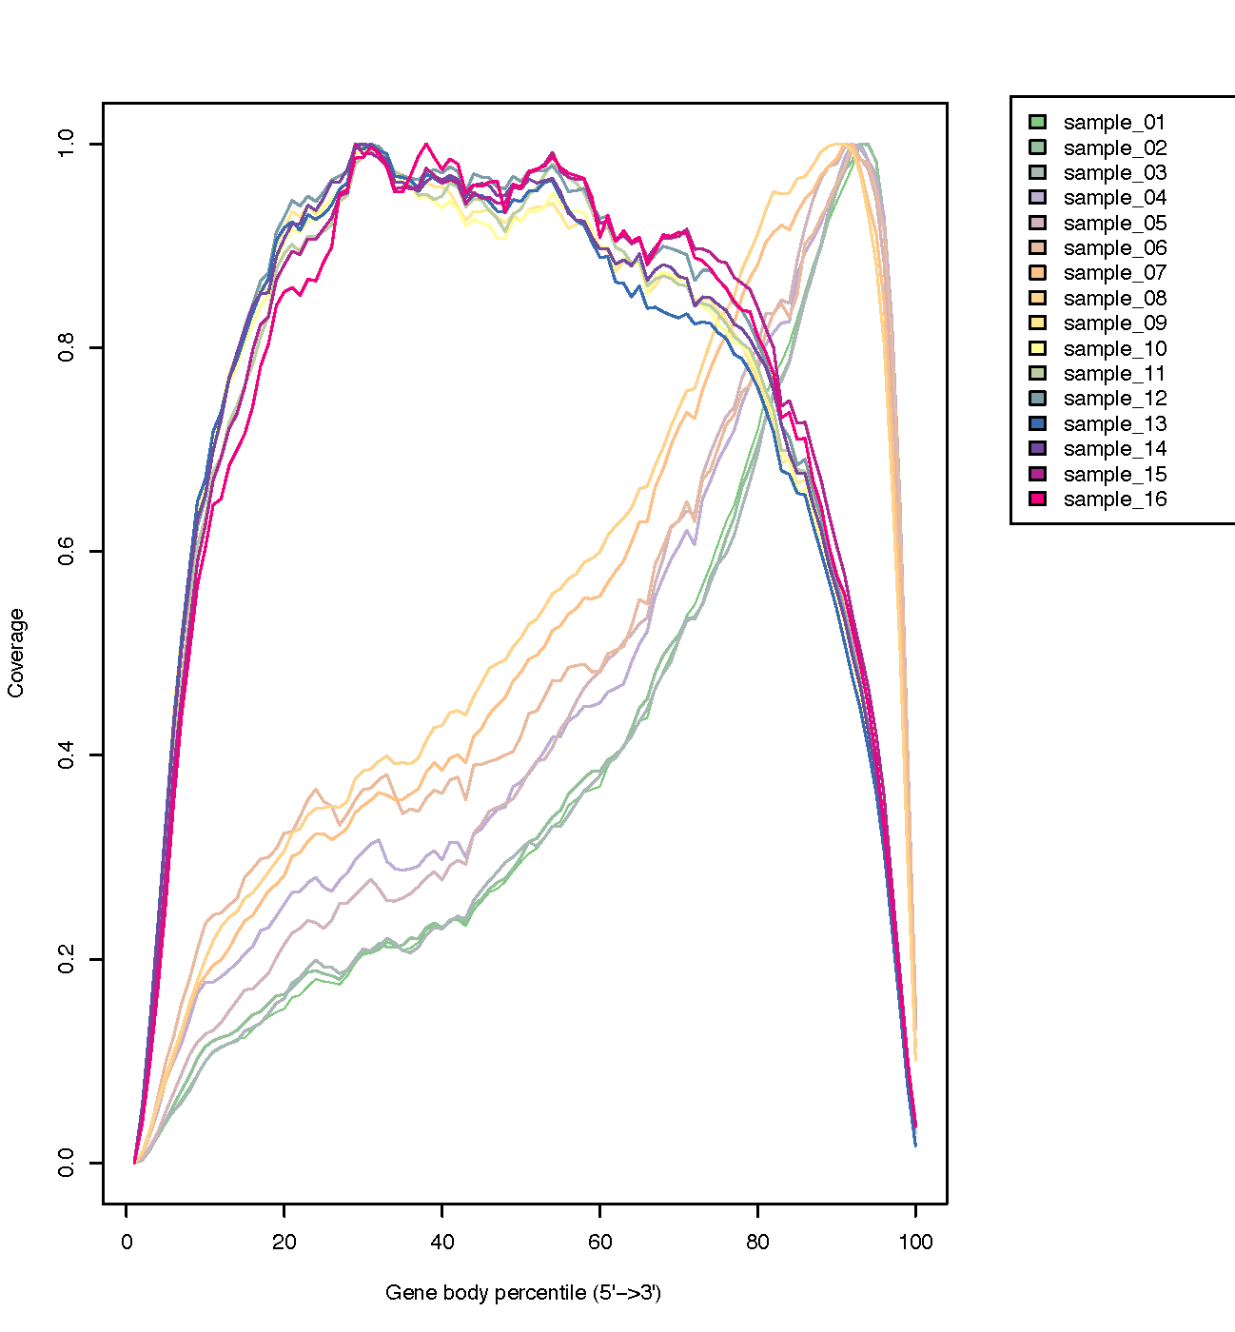
Common tools
Adapter removal
Trimmomatic
cutAdapt
Quality control
FastQC, MultiQC
Samtools
RSeQC
RSeQC – gene body coverage showing Total RNA-seq and mRNA-seq gene body coverage
BNFO 262 Winter 2026​

Slide 23
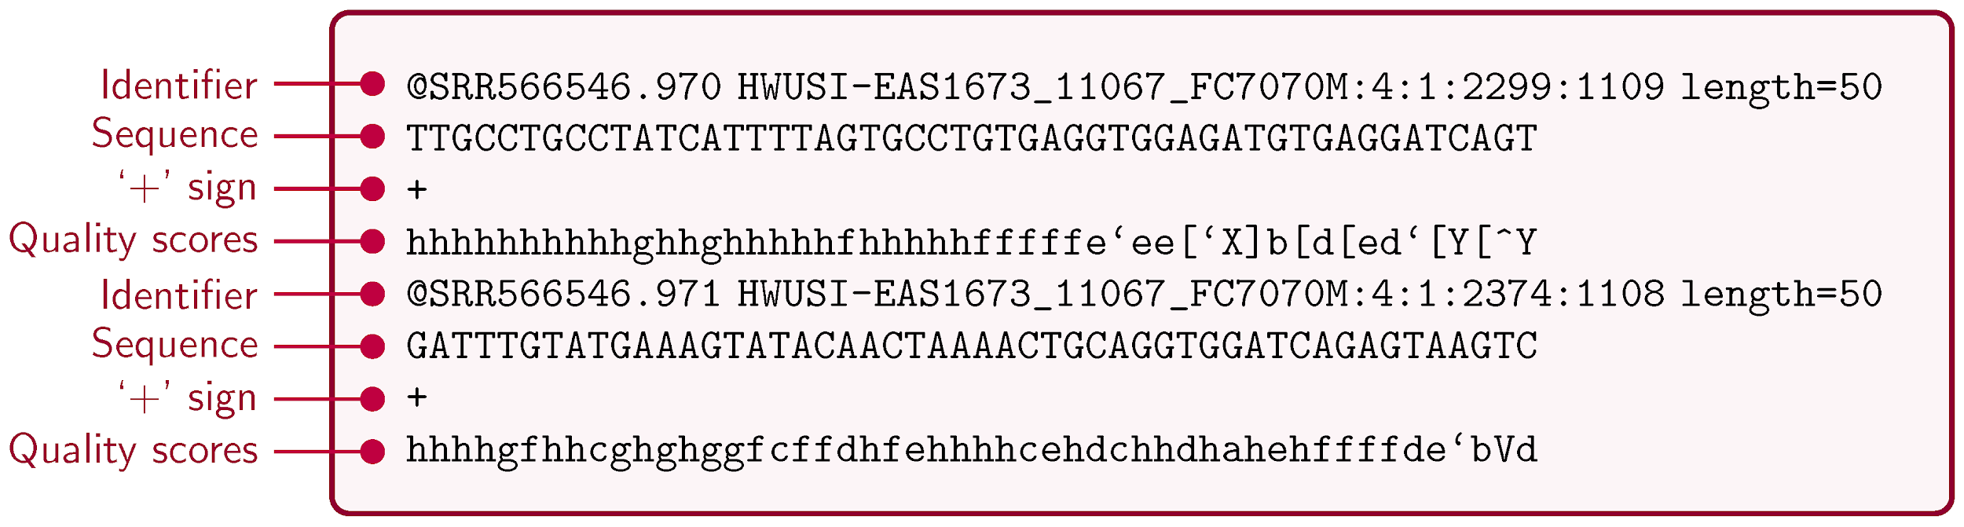
FASTQ File Format
A FASTQ file is a text file for sequence data and relevant metadata.
One read
Another read
Line 1 begins with an '@' character and is followed by a sequence identifier and an optional description (like a FASTA title line).
Line 2 is the raw sequence letters.
Line 3 begins with a '+' character and is optionally followed by the same sequence identifier (and any description) again.
Line 4 encodes the quality values for the sequence in Line 2 and must contain the same number of symbols as letters in the sequence.
BNFO 262 Winter 2026​
Notes:
Information:
Hosseini, Morteza, Diogo Pratas, and Armando J. Pinho. "A survey on data compression methods for biological sequences." Information 7.4 (2016): 56.
Script:
The FASTQ file format was derived from the simple text format for nucleic acid or protein sequences, FASTA.
FASTQ bundles the sequence of every single read produced during a sequencing run together with the quality
scores. FASTQ files are uncompressed and quite large because they contain the following information for every
single sequencing read:
1. @ followed by the read ID and possibly information about the sequencing run
2. sequenced bases
3. + (perhaps followed by the read ID again, or some other description)
4. quality scores for each base of the sequence (ASCII-encoded, see below)
American Standard Code for Information Interchange, is a character encoding standard for electronic communication. ASCII codes represent text in computers, telecommunications equipment, and other devices.
The byte representing quality runs from 0x21 (lowest quality; '!' in ASCII) to 0x7e (highest quality; '~' in ASCII). Here are the quality value characters in left-to-right increasing order of quality (ASCII):
!"#$%&'()*+,-./0123456789:;<=>?@ABCDEFGHIJKLMNOPQRSTUVWXYZ[\]^_`abcdefghijklmnopqrstuvwxyz{|}~

Slide 24
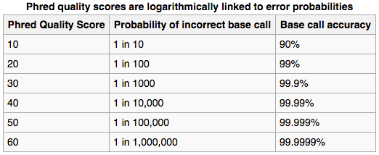
Fastq File – Phred Quality Score
Quality scores (Q) report the probability that the base call is incorrect. (P) is the probability that the base call is false.
Q = -10 log₁₀ P
Q
Probability of error
Q
Probability of error
Field standard is to accept bases with Q>20 (older standard)
BNFO 262 Winter 2026​
Notes:
Script:
-Phred quality scores are defined as a property which is logarithmically related to the base-calling error probabilities
-The quality of a given base call is measured as a Phred quality score and indicates the probability of the base being called correctly
-The scores generally range from 2 to 40 with higher scores indicating greater confidence in the call.
Information:
https://www.sciencedirect.com/science/article/pii/B9780128096338200940
The quality of a given base call is measured as a Phred quality score and indicates the probability of the base being called correctly. The scores generally range from 2 to 40 with higher scores indicating greater confidence in the call. A common practice is to filter out bases with Phred scores below 20, although individual preferences may lead some researchers to modulate this threshold. The removal of redundant reads and undesired sequences (such as 3′ adaptors, contaminants, or primers) is essential as contaminating sequences will not align to the genome resulting in poor alignment quality. Trimming low quality ends from reads is important as current sequencers are highly error-prone, with a significant dip in base quality at the 3′ ends of reads.

Slide 25
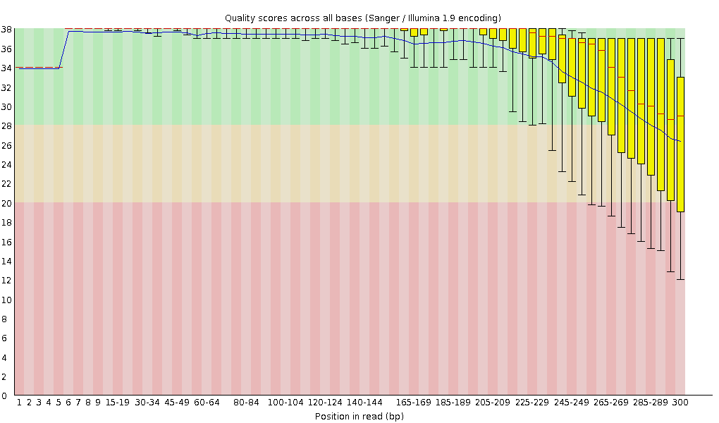
Example Fastqc Output: Lower Quality Scores at the End of Reads
Running fastqc is as easy as $ fastqc *.fq- more in the upcoming exercises
30
Quality score
20
0
100
200
300
Position in read (bp)
BNFO 262 Winter 2026​
Notes:
Information:
https://hbctraining.github.io/Intro-to-rnaseq-hpc-salmon/lessons/qc_fastqc_assessment.html
https://www.ecseq.com/support/ngs/why-does-the-sequence-quality-decrease-over-the-read-in-illumina
Script:
One of the most important analysis modules is the “Per base sequence quality” plot. This plot provides the distribution of quality scores at each position in the read across all reads. This plot can alert us to whether there were any problems occurring during sequencing and whether we might need to contact the sequencing facility.
The y-axis gives the quality scores, while the x-axis represents the position in the read. The color coding of the plot denotes what are considered high, medium and low quality scores.
The quality scores appear to drop going from the beginning toward the end of the reads. For reads generated by Illumina sequencing, this is not unexpected, and there are known causes for this drop in quality. To better interpret this plot it is helpful to understand the different sequencing error profiles.
https://www.ecseq.com/support/ngs/why-does-the-sequence-quality-decrease-over-the-read-in-illumina
Illumina relies on the sequencing by synthesis procedure. During each cycle of the process the sequencer washes chemicals that include variants for all four nucleotide over the flow cell (which has different clusters with identical DNA fragments for each cluster). The nucleotides have a blocker (terminator cap) so that only 1 base gets added to each molecule of DNA at a time. After the detection of the coupled fluorescence signal the blocker can be removed and the cycle can start again. This way, the DNA fragments in each cluster get sequenced synchronously by expressing specific fluorescence signals.
During the sequencing process different errors can occur. The main reason for the decreasing sequence quality is the so-called phasing. Phasing means that the blocker of a nucleotide is not correctly removed after signal detection. In the next cycle no new nucleotide can bind on this DNA fragment and the old nucleotide is detected one more time whereby the fluorescence signal of this old nucleotide (probably) differs from the synchronous signal of the other nucleotides. From now on this DNA fragment will be 1 cycle behind the rest (out of phase), polluting the light signal that the sequencer's camera has to read. A similar effect occurs if a nucleotide has a defect terminator cap (prephasing). In this case two nucleotides can bind in one cycle whereby the fragment will be 1 cycle before the rest. These errors occur with a low probability. But over time (with increasing read length) they add up and pollute the light signal more and more. The signal gets more and more asynchronous. And since the light signal is used to calculate quality scores the asynchronous signal results in a decreasing sequence quality score.

Slide 26
Workflow: Read Mapping
FASTQ
SAM/BAM
Counts Matrix Table
Raw reads
Quality control
Quality control
fastq
Adapter removal
fastq
Trimmed reads
fastq
Read mapping
sam/bam
Read quantification
table
Functional analysis
fastq
Alignment free quantification
table
BNFO 262 Winter 2026​

Slide 27
Common Tools
Read mapping
STAR (considered "gold standard" for short-read data)
Bowtie
HISAT2
TopHat
Minimap2 (considered "gold standard" for long-read data)
Read quantification
featureCounts
HTseq-count
RSEM
Salmon/Kalisto (alignment-free)
BNFO 262 Winter 2026​

Slide 28
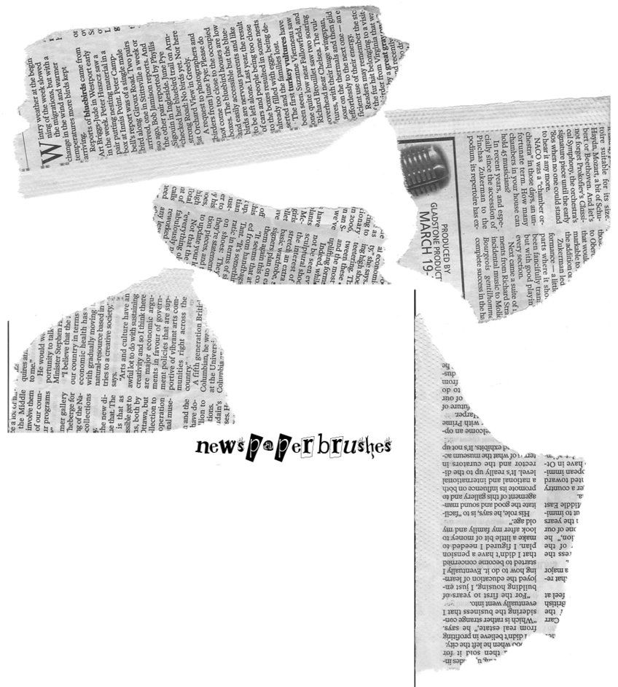
What is Mapping/Alignment?
The process of finding where in the genome a sequence is from.
Read
CGCATCAGT
Aligned read
CGCATCAGT
Reference genome
...ACTTGACGCATCAGTTGAAACGTA..
chr1:105833
105843
105853
BNFO 262 Winter 2026​
Notes:
Script:
-Reads are aligned to genome
-Model organisms (human, mouse, etc) and non-model organisms
-STAR generates output files that can be used for many downstream analyses such as transcript/gene expression quantification, differential gene expression, novel isoform reconstruction, signal visualization, and so forth
-Newspaper analogy

Slide 29
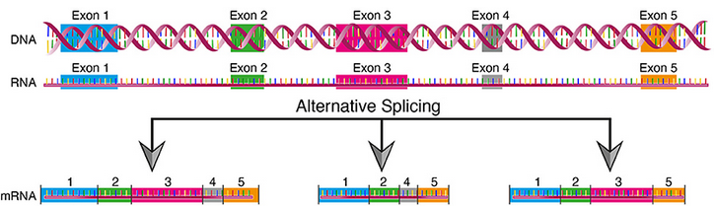
Short Read Alignment is Complicated
Alignment must consider non-exact matching.
Other factors:
Splicing
Repeats
Pseudogenes
Unfinished regions
Insertion
CGCATGAAGT
Deletion
C-CATAAGT
Substitution
CGCATAAGT
Reference genome
...ACTTGACGCATCAGTTGAAACGTA...
chr1:105833
105843
105853
BNFO 262 Winter 2026​
Notes:
Script:
Insertion, deletion or substitution of bases
Splicing-premRNA made into mRNA. Introns removed to form exons
Splice variant-Genetic alteration that occurs at boundary of exon and intron. Can disrupt RNA splicing resulting in loss of exons/inclusion of intron/altered protein coding
Psuedogene- resembles a gene but has mutated to be inactive over the course of evolution

Slide 30
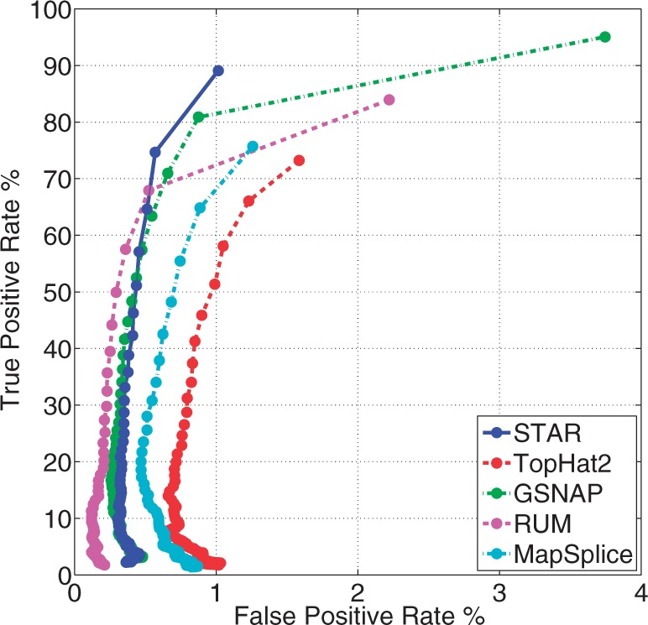
Splice-aware mapping with STAR Aligner
STAR = Spliced Transcripts Alignment to Reference
Other Splice-aware options: HISAT2, MapSplice, SOAPSplice, Passion, SpliceMap, RUM, ABMapper, HMMSplicer
BNFO 262 Winter 2026​

Slide 31
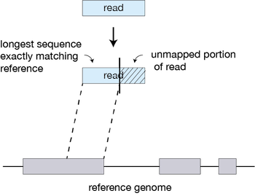
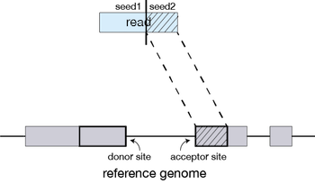
STAR Alignment Strategy
Seed Searching
STAR searches for the longest sequence that exactly matches one or more locations on the reference genome. These longest matching sequences are called the Maximal Mappable Prefixes (MMPs)
First MMP is seed1. STAR then searches again for only the unmapped portion of the read or the second MMP (seed2)
BNFO 262 Winter 2026​
Notes:
sequential searching of only the unmapped portions of reads underlies the efficiency of the STAR algorithm. STAR uses an uncompressed suffix array (SA) to efficiently search for the MMPs, this allows for quick searching against even the largest reference genomes. Other slower aligners use algorithms that often search for the entire read sequence before splitting reads and performing iterative rounds of mapping.

Slide 32
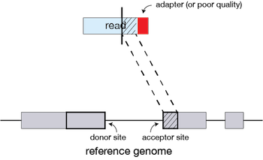
STAR Alignment Strategy​
Seed searching (cont.)
If extension does not give a good alignment, then the poor quality or adapter sequence (or other contaminating sequence) will be soft clipped.
BNFO 262 Winter 2026​

Slide 33
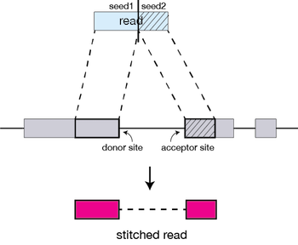
STAR Alignment Strategy
2) Clustering, stitching, and scoring
The separate seeds are stitched together to create a complete read by first clustering the seeds together based on proximity to a set of ‘anchor’ seeds, or seeds that are not multi-mapping.
Then the seeds are stitched together based on the best alignment for the read (scoring based on mismatches, indels, gaps, etc.).
BNFO 262 Winter 2026​

Slide 34
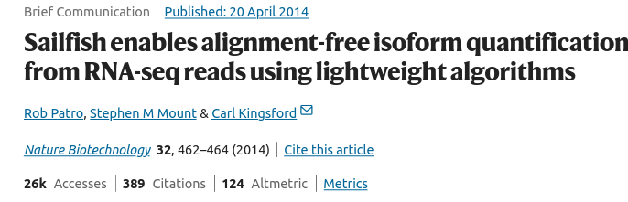
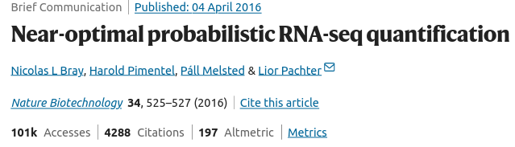
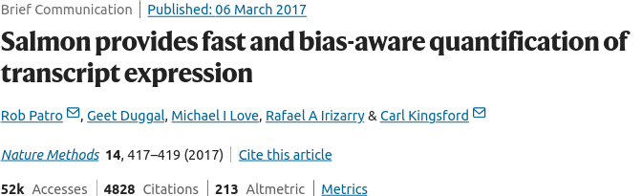
Quasi-alignment – alignment-free (pseudocounts)
Base-to-base alignment is avoided making these tools more than 20 times faster than standard mapping
BNFO 262 Winter 2026​

Slide 35
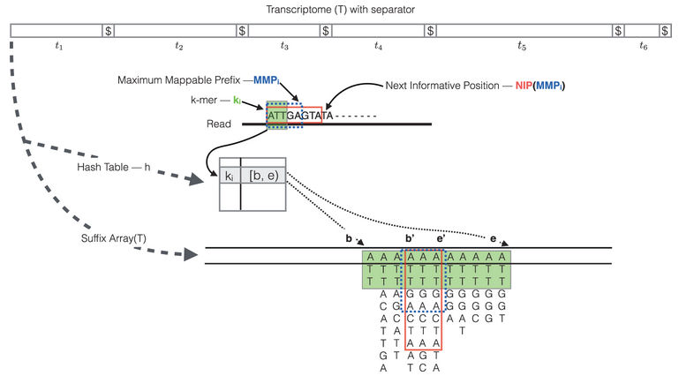
Quasi-alignment – how does it work?
Indexing:
Suffix array (SA): reference transcriptome – sorted integer array of all possible transcript suffixes
Hash Table: used to map each k-mer in the reference transcriptome to it's location in the SA
Quasi-mapping procedure:
The read is scanned from left to right until a k-mer appears in the hash table
The k-mer is looked up in the hash table and the SA intervals are retrieved, giving all suffixes containing that k-mer
Similar to STAR, the maximal matching prefix (MMP) is identified by finding the longest read sequence that exactly matches the reference suffixes.
Instead of searching for the next MMP in the read as we do with STAR, Salmon uses a k-mer skipping approach to identify the next informative position (NIP)
This process is repeated until the end of the read.
The final set of mappings is determined by a consensus mechanism.
Sample specific bias models to improve abundance estimates:
GC bias, positional coverage biases, sequence biases at 5’ and 3’ ends of the fragments, fragment length distribution, and strand-specific methods
BNFO 262 Winter 2026​
Notes:
Figure: RapMap: a rapid, sensitive and accurate tool for mapping RNA-seq reads to transcriptomes. A. Srivastava, H. Sarkar, N. Gupta, R. Patro. Bioinformatics (2016) 32 (12): i192-i200.
The quasi-mapping procedure performs the following steps [3]:
The read is scanned from left to right until a k-mer that appears in the hash table is discovered.
The k-mer is looked up in the hash table and the SA intervals are retrieved, giving all suffixes containing that k-mer
Similar to STAR, the maximal matching prefix (MMP) is identified by finding the longest read sequence that exactly matches the reference suffixes.
Instead of searching for the next MMP in the read as we do with STAR, Salmon uses a k-mer skipping approach to identify the next informative position (NIP). In this way the SA search is likely to return a different set of transcripts than those returned for the previous MMP. Often natural variation or a sequencing error in the read is the cause of the mismatch from the reference, so beginning the search at this position would likely return the same set of transcripts.
This process is repeated until the end of the read.
The final set of mappings is determined by a consensus mechanism. Specifically, the algorithm reports the intersection of transcripts appearing in all MMPs for that read. The transcripts, orientation and transcript location are output for each read.

Slide 36
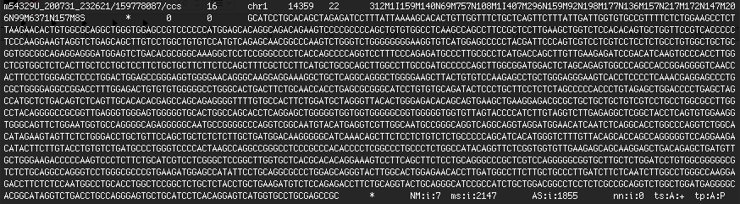
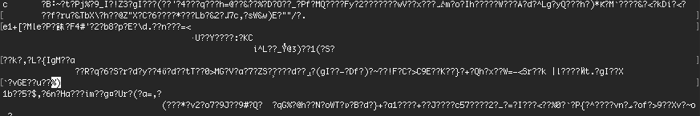
SAM/BAM Files
Sequence Alignment Map (SAM) files : a text-based format used to store aligned sequence data
BAM file is the compressed binary version of a SAM file
SAM
BAM
BNFO 262 Winter 2026​
Notes:
SAM: Text-based means human-readable

Slide 37
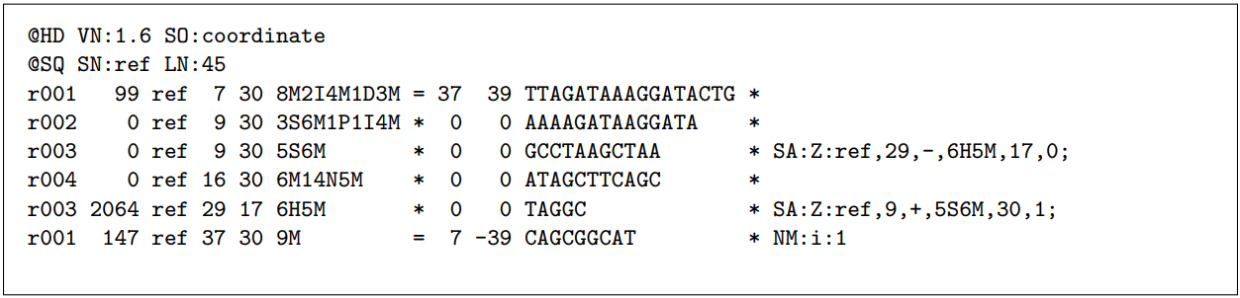
SAM/BAM Files: What Does it all Mean?!
QNAME
Header
CIGAR
FLAG
Don’t memorize; documentation is your friend! All 11 columns explained!
Samtools file format docs: http://samtools.github.io/hts-specs/
BNFO 262 Winter 2026​
Notes:
Header: describes source of data, reference sequence, alignment method
QNAME: Query template name – read name
RNAME: "ref" but is often "chr1 etc."
Position: 1-based leftmost position of the read
MAPX – alignment quality (30 in our case here)
FLAG: Combination of bitwise flag (pairing/strand/mate strand)

Slide 38
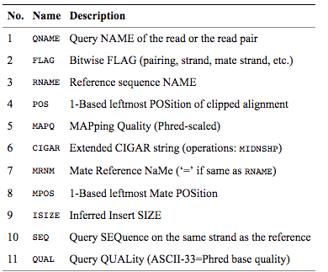
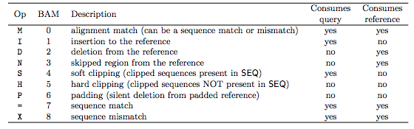
SAM/BAM file – Getting Information about a Specific Read
Examples of questions you might ask about a read:
1) What does this flag number mean?
https://broadinstitute.github.io/picard/explain-flags.html
2) How many bases in the read were aligned?
*** Remember that you need to use samtools to view a BAM file
BNFO 262 Winter 2026​
Notes:
Information:
Bioinformatics. 2009 Aug 15;25(16):2078-9. Epub 2009 Jun 8. The Sequence Alignment/Map format and SAMtools.
https://jef.works/blog/2017/03/28/CIGAR-strings-for-dummies/
CIGAR string: Contains specific information about the mapping information at specific positions across the read
The ‘CIGAR’ (Compact Idiosyncratic Gapped Alignment Report) string is how the SAM/BAM format represents spliced alignments.

Slide 39
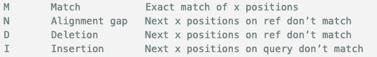
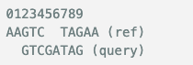
CIGAR Score
Compact Idiosyncratic Gapped Alignment Report string is how the SAM/BAM format represents spliced alignments
The shown alignment will give position=2 (0-based) and CIGAR=3M2I3M
BNFO 262 Winter 2026​

Slide 40
Workflow: Read Quantification
FASTQ
SAM/BAM
Counts Matrix Table
Raw reads
Quality control
Quality control
fastq
Adapter removal
fastq
Trimmed reads
fastq
Read mapping
sam/bam
Read quantification
table
Functional analysis
fastq
Alignment free quantification
table
BNFO 262 Winter 2026​

Slide 41
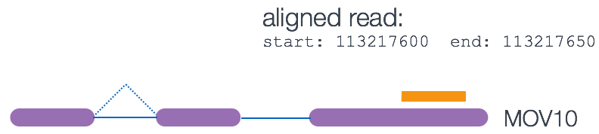
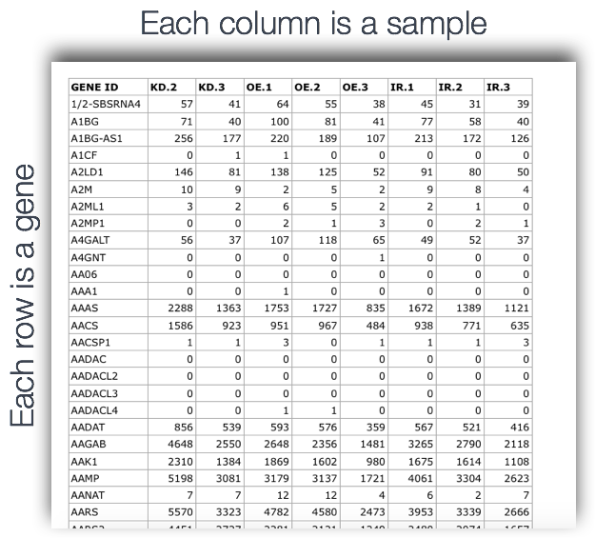
Read Quantification: Counting Reads per Gene
intron
exon
intron
exon
exon
BNFO 262 Winter 2026​
Notes:
Figures and information:
https://hbctraining.github.io/Intro-to-rnaseq-hpc-O2/lessons/05_counting_reads.html
featureCounts
Script:
-Output of counting is a count matrix, with genes as rows and samples are columns
-These are the “raw” counts and will be used in statistical programs downstream for differential gene expression.
-It counts reads that map to a single location (uniquely mapping)

Slide 42
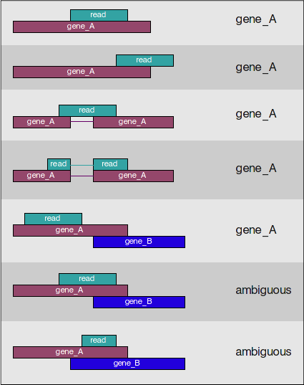
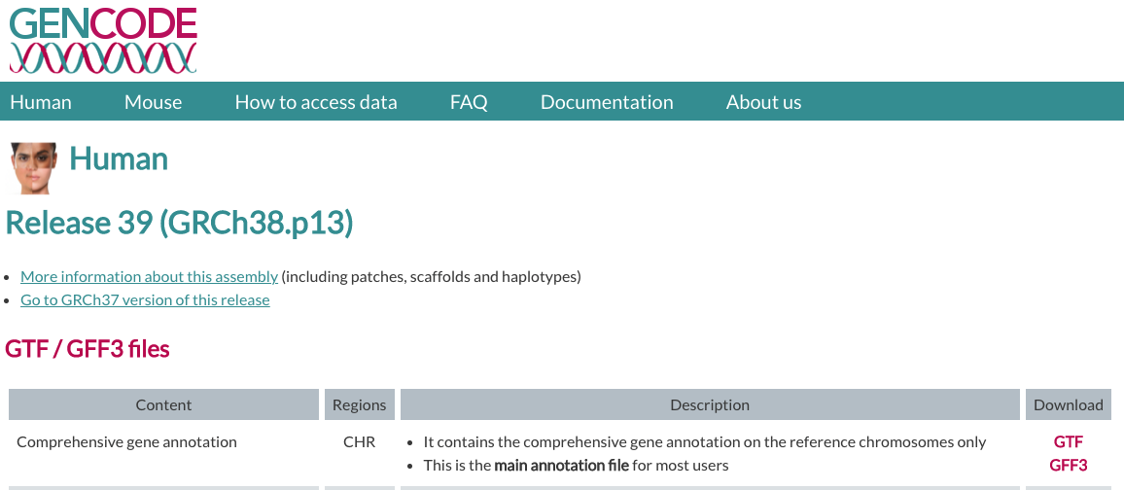
Subread: featureCounts
featureCounts: https://bioconductor.org/packages/release/bioc/vignettes/Rsubread/inst/doc/SubreadUsersGuide.pdf
Multiple SAM/BAM files + 1 GTF file
BNFO 262 Winter 2026​
Notes:
Information and figure:
https://hbctraining.github.io/Intro-to-rnaseq-hpc-O2/lessons/05_counting_reads.html
https://www.biostars.org/p/212594/
Script:
-Mapping can be done to single or multiple location
-Single location- total read count = sum of reads associated with each exon that belongs to that gene
-Multimapping- Overcounting the number or reads- issues with normalization
-You need SAM/BAM files and GTF (general transfer file format)
-Genome index: Indexing a genome can be explained similar to indexing a book. Indices allow the aligner to narrow down the potential origin of a query sequence within the genome, saving both time and memory.

Slide 43
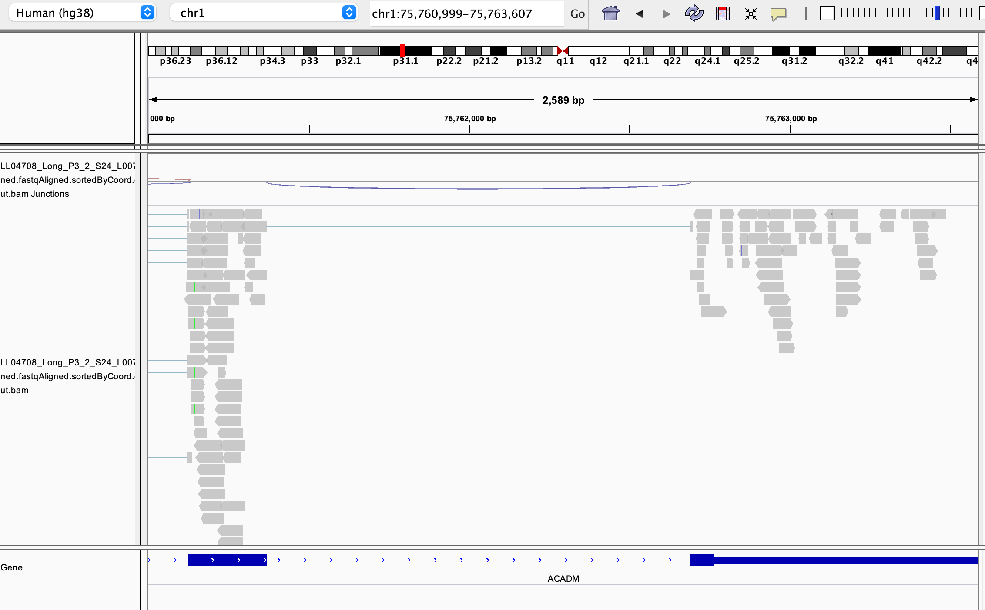
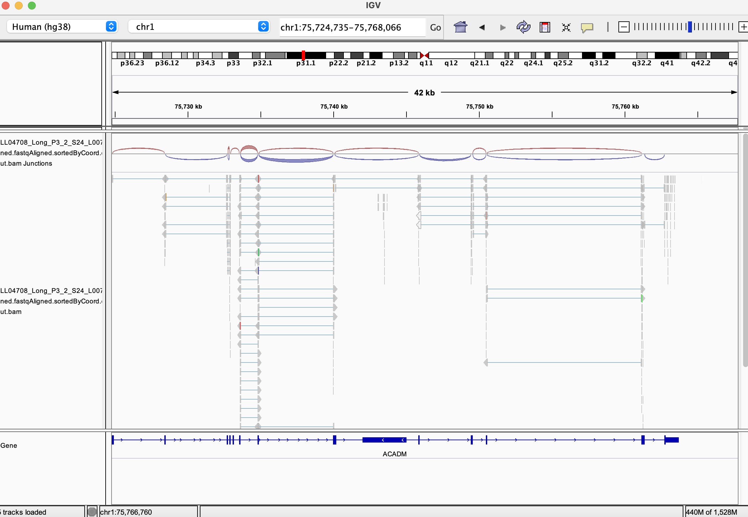
Interactive Genomics Viewer (IGV)
BNFO 262 Winter 2026​
Visual verification of alignments and features
Notes:
.bam file, .bai file, reference genome

Slide 44
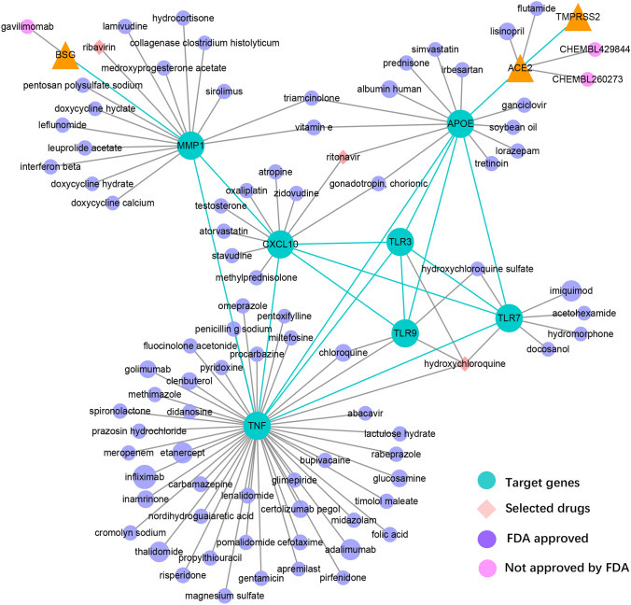
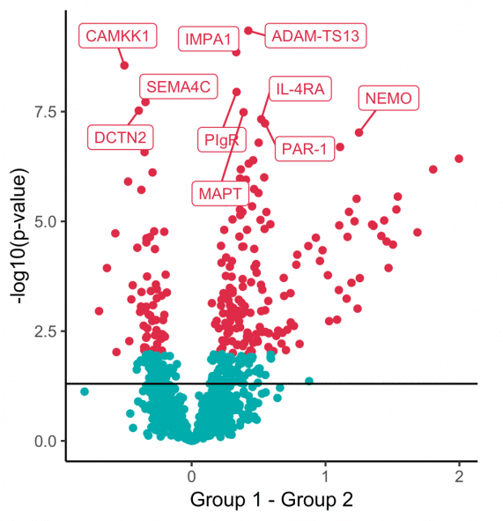

Functional Analysis
Gene Co-expression Networks
Differential expression
Gene Set Enrichment Analysis (GSEA)
BNFO 262 Winter 2026​

Slide 45
RNA-seq Workflow Summary
Part 1: Data Generation
Experimental Design → RNA Extraction → Library Preparation → QC → Sequencing
Key decision: rRNA depletion (degraded RNA) vs. Poly(A) selection (high-quality mRNA)
Quality control at every step ensures reliable downstream analysis
Part 2: Data Analysis
QC (FastQC) → Trimming → Alignment (STAR/Salmon) → Quantification (featureCounts)
File formats: FASTQ → SAM/BAM → Count matrix
Alternative: Quasi-alignment (Salmon/Kallisto) - 20x faster, transcript-level counts
Output: Gene expression matrix ready for differential expression analysis
Key Takeaway
RNA-seq workflow transforms biological samples into quantitative gene expression data through careful experimental design, quality control, and computational analysis

Slide 46

Break: 10 min
BNFO 262 Winter 2026​

Slide 47
Exercise: RNA-Seq Differential Expression Data Preparation Part 1: FASTQ file quality control
BNFO 262 Winter 2026​

Slide 48
FASTQC interpretation
Per base sequence quality” plot provides the distribution of quality scores at each position in the read across all reads. This plot can alert us to whether there were any problems occurring during sequencing and whether we might need to contact the sequencing facility.
“Per sequence quality scores” plot gives you the average quality score on the x-axis and the number of sequences with that average on the y-axis. We hope the majority of our reads have a high average quality score with no large bumps at the lower quality values.
“Per base sequence content”, which always gives a FAIL for RNA-seq data. This is because the first 10-12 bases result from the ‘random’ hexamer priming that occurs during RNA-seq library preparation. This priming is not as random as we might hope giving an enrichment in particular bases for these initial nucleotides.
BNFO 262 Winter 2026​
Notes:
Information:
https://hbctraining.github.io/Intro-to-rnaseq-hpc-salmon/lessons/qc_fastqc_assessment.html

Slide 49
FASTQC interpretation
“Per sequence GC content” plot gives the GC distribution over all sequences. Generally, is a good idea to note whether the GC content of the central peak corresponds to the expected % GC for the organism. Also, the distribution should be normal unless over-represented sequences (sharp peaks on a normal distribution) or contamination with another organism (broad peak).
“Per base N content” plots % of bases not called with sufficient confidence and replaced with N. >5% is a warning and >20% is a failure.
Sequence length distribution plots a graph showing the distribution of fragment sizes in the file which was analyzed.
BNFO 262 Winter 2026​
Notes:
Information:
https://hbctraining.github.io/Intro-to-rnaseq-hpc-salmon/lessons/qc_fastqc_assessment.html
https://www.bioinformatics.babraham.ac.uk/projects/fastqc/Help/3%20Analysis%20Modules/6%20Per%20Base%20N%20Content.html
https://www.bioinformatics.babraham.ac.uk/projects/fastqc/Help/3%20Analysis%20Modules/7%20Sequence%20Length%20Distribution.html

Slide 50
FASTQC interpretation
Sequence duplication levels counts the degree of duplication for every sequence in a library and creates a plot showing the relative number of sequences with different degrees of duplication. Warning is generated if duplicated sequences are >20% and failure if >50%.
“Overrepresented sequences” table is another important module as it displays the sequences (at least 20 bp) that occur in more than 0.1% of the total number of sequences. This table aids in identifying contamination, such as vector or adapter sequences. If the %GC content was off in the above module, this table can help identify the source. If not listed as a known adapter or vector, it can help to BLAST the sequence to determine the identity.
BNFO 262 Winter 2026​
Notes:
Information:
https://hbctraining.github.io/Intro-to-rnaseq-hpc-salmon/lessons/qc_fastqc_assessment.html
https://www.bioinformatics.babraham.ac.uk/projects/fastqc/Help/3%20Analysis%20Modules/6%20Per%20Base%20N%20Content.html
https://www.bioinformatics.babraham.ac.uk/projects/fastqc/Help/3%20Analysis%20Modules/8%20Duplicate%20Sequences.html

Slide 51
Exercise: RNA-Seq Differential Expression Data Preparation Part 2: STAR Alignment and QC
BNFO 262 Winter 2026​

Slide 52
Thank You!
A/Prof. Alon Goren
Teaching Assistants:
Jenny Dong
Yuwei Cao
BNFO 262 Winter 2026​

Slide 53
Supplemental Slides
BNFO 262 Winter 2026​

Slide 54



Illumina SBS
BNFO 262 Winter 2026​
Notes:
Figures: https://www.youtube.com/watch?v=oIJaA6h2bFM
Script:
-The nucleotide order of each fragment is revealed through PCR with fluorophore-labelled nucleotides
-Each nucleotide contains a fluorescent tag and a reversible terminator that blocks incorporation of the next base
-The fluorescent signal indicates which nucleotide has been added, and the terminator is cleaved so the next base can bind.
-Images are taken after each round of nucleotide incorporation and bases are identified based on the recorded excitation spectra
-Previously 4 channel, now 2 channel
-After reading the forward DNA strand, the reads are washed away, and the process repeats for the reverse strand. This method is called paired-end sequencing.
Information:
https://bitesizebio.com/13546/sequencing-by-synthesis-explaining-the-illumina-sequencing-technology/
The Solexa/Illumina sequencing method is similar to Sanger sequencing, but it uses modified dNTPs containing a terminator which blocks further polymerization- so only a single base can be added by a polymerase enzyme to each growing DNA copy strand. The sequencing reaction is conducted simultaneously on a very large number (many millions in fact) of different template molecules spread out on a solid surface. The terminator also contains a fluorescent label, which can be detected by a camera. Only a single fluorescent color is used, so each of the four bases must be added in a separate cycle of DNA synthesis and imaging. Following the addition of the four dNTPs to the templates, the images are recorded and the terminators are removed. This chemistry is called “reversible terminators”. Finally, another four cycles of dNTP additions are initiated. Since single bases are added to all templates in a uniform fashion, the sequencing process produces a set of DNA sequence reads of uniform length.
http://data-science-sequencing.github.io/Win2018/lectures/lecture2/#illumina
DNA polymerase naturally uses dNTPs to synthesize a new strand. The synthesis process occurs very quickly, making it hard to make any sort of measurement during synthesis. Sanger overcame this problem by figuring out a way to terminate synthesis using a modified version of dNTPs called ddNTPs (dideoxynucleotide triphosphates). DNA polymerase can attach a ddNTP to the sequence just like with dNTPs, but it cannot attach anything to the ddNTP. In other words, the attachment of a ddNTP halts the replication of the DNA molecule.

Slide 55

Illumina SBS
4-channel: 4 distinct ‘colors’ for calling the DNA bases
Each of the four nucleotides is labeled with a separate dye. In each amplification cycle these dye signals are imaged by using two lasers and four filters
MiniSeq, NextSeq and NovaSeq, Illumina uses an alternative system with just two dyes
2-channel: Red channel- C, Green- T, Red and green- A, Unlabeled-G
BNFO 262 Winter 2026​
Notes:
https://www.ecseq.com/support/ngs/do_you_have_two_colors_or_four_colors_in_Illumina

Slide 56

Transcript Info Captured by Each Technology
BNFO 262 Winter 2026​
Stark et al 2019, Nat Rev Genetics 20, 631-956
Notes:
Over 90% of human genes (gene n) are alternatively spliced to form two or more distinct and expressed isoforms (transcripts x and y).
The complexity of information captured increases from short-read cDNA sequencing, where isoform detection can be compromised by reads that cannot be mapped unambiguously, to long-read methods that directly sequence isoforms. In short-read cDNA sequencing, a significant proportion of reads map ambiguously when an exon is shared between isoforms; reads that span exon–exon junctions can be used to improve the isoform analysis but can also be mapped ambiguously when a junction is shared between isoforms. These issues complicate analysis and the interpretation of results. Long-read cDNA methods can generate full-length isoform reads that remove, or substantially reduce, these artefacts and improve differential isoform expression analysis. However, these methods rely on cDNA conversion, which removes information about RNA base modifications and can only make crude estimates of polyadenylation (poly(A)) tail length. Direct RNA-seq enables full-length isoform analysis, base modification detection (such as N6-methyladenosine (m6 A)) and poly(A) tail length estimation.

Slide 57

Workflows for DGE
BNFO 262 Winter 2026​
Notes:
In workflow A, aligners such as TopHat¹¹², STAR¹¹³ or HISAT2 (ref.¹¹⁴) use a reference genome to map reads to genomic locations, and then quantification tools, such as HTSeq¹³³ and featureCounts¹³⁴, assign reads to features. After normalization (usually using methods embedded in the quantification or expression modelling tools, such as trimmed mean of M-values (TMM)¹⁴²), gene expression is modelled using tools such as edgeR¹⁴³, DESeq2 (ref.¹⁵⁵) and limma+voom¹⁵⁶, and a list of differentially expressed genes or transcripts is generated for further visualization and interpretation. In workflow B, newer, alignment-free tools, such as Kallisto¹¹⁹ and Salmon¹²⁰, assemble a transcriptome and quantify abundance in one step. The output from these tools is usually converted to count estimates (using tximport¹³⁰ (TXI)) and run through the same normalization and modelling used in workflow A, to output a list of differentially expressed genes or transcripts. Alternatively, workflow C begins by aligning the reads (typically performed with TopHat¹¹², although STAR¹¹³ and HISAT¹¹⁴ can also be used), followed by the use of CuffLinks¹³¹ to process raw reads and the CuffDiff2 package to output transcript abundance estimates and a list of differentially expressed genes or transcripts. Other tools in common use include StringTie¹¹⁶, which assembles a transcriptome model from TopHat¹¹² (or similar tools) before the results are passed through to RSEM¹⁰⁵ or MMSEQ¹³² to estimate transcript abundance, and then to Ballgown¹⁵⁷ to identify differentially expressed genes or transcripts, and SOAPdenovo-trans¹¹⁷, which simultaneously aligns and assembles reads for analysis via the path of choice

